Slide 1





The Business Environment
Business organizations: The external environment
Course Instructor: Noshin Anjum Chaiti
Notes:
‹#›

Slide 2
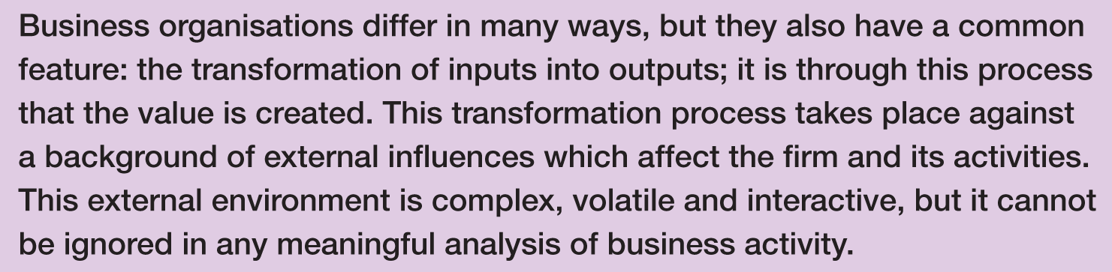

Introduction
Notes:
‹#›

Slide 3
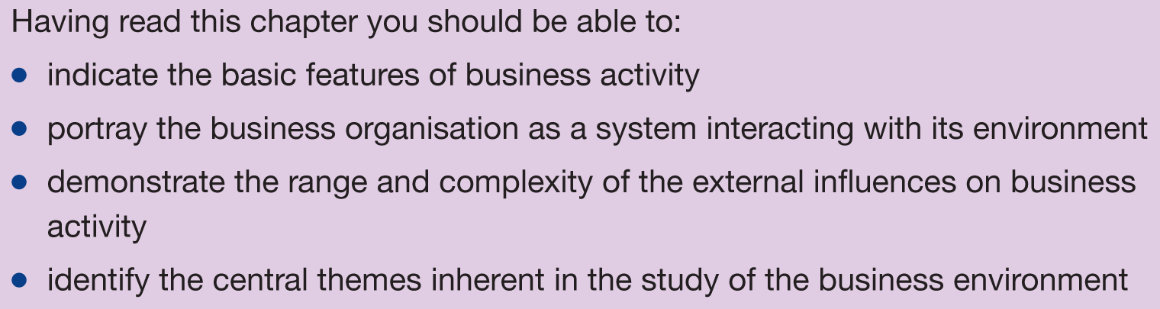
Learning outcomes

Slide 4
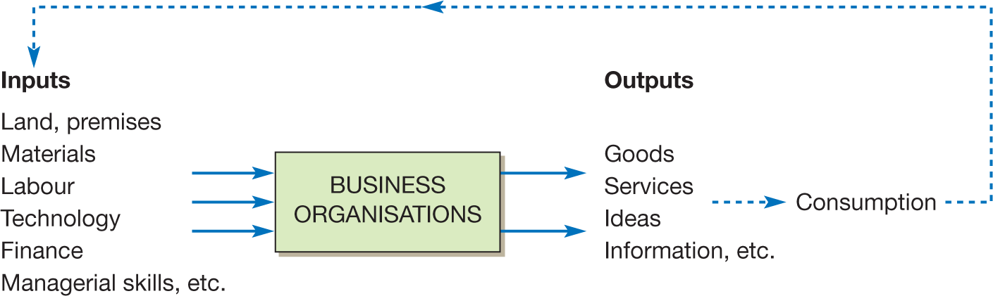
The business organisation as a transformation system

Slide 5
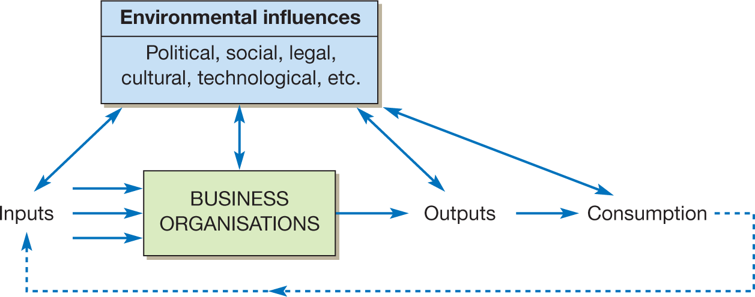
The firm in its environment

Slide 6
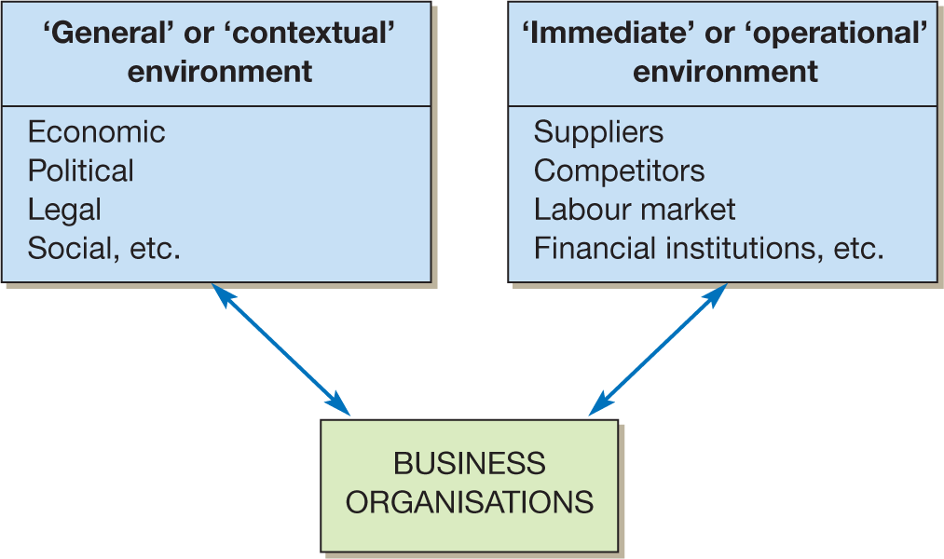
Two levels of environment

Slide 7
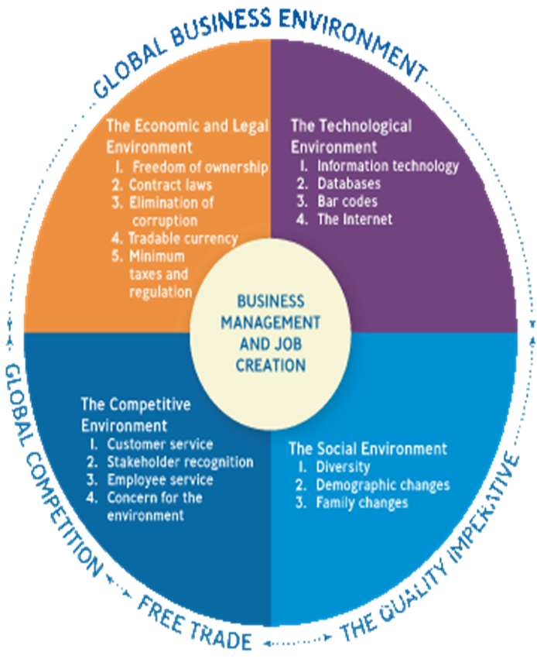
Business Environment The Business Environment is the sum total of all external and internal factors that influence a business. An external business environment is composed of all the outside factors or influences that impact the operation of business.
*
*
1-‹#›
‹#›
Notes:
Copyright @2020 Nusrat Hafiz. All Rights Reserved.
Introduction to Business (BUS 101). Course Instructor: Nusrat Hafiz (NHF)

Slide 8
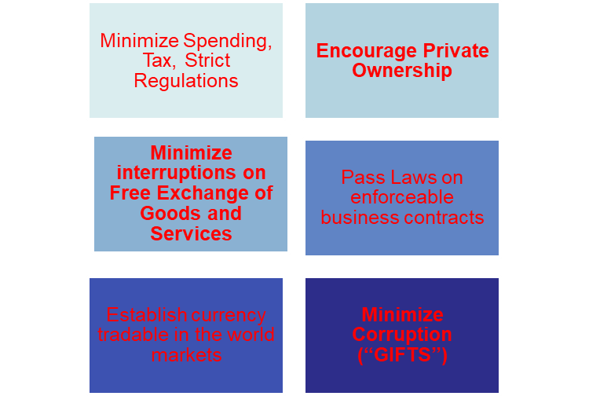
1. Economic & Legal Environment
Government actions which affects the operations of a
company or business. A government can promote business
through:
*
1-‹#›
‹#›
Notes:
‹#›
Copyright @2020 Nusrat Hafiz. All Rights Reserved.
Introduction to Business (BUS 101). Course Instructor: Nusrat Hafiz (NHF)

Slide 9


1. Economic & Legal Environment
*
1-‹#›
‹#›
Notes:
‹#›
Copyright @2020 Nusrat Hafiz. All Rights Reserved.
Introduction to Business (BUS 101). Course Instructor: Nusrat Hafiz (NHF)

Slide 10
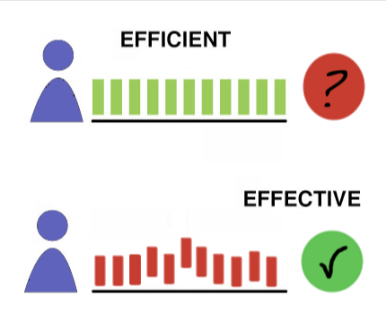
2. TECHNOLOGICAL ENVIRONMENT
Technology -- Everything from phones to copiers and the various
software programs that make businesses more effective, efficient
and productive.
Effectiveness -- Producing the desired result.
(doing the right things)
Efficiency -- Producing goods and services using
the least amount of resources. (doing thing right)
Productivity -- The amount of output you generate given the amount of input (example: hours you work).
*
1-‹#›
‹#›
Notes:
‹#›

Slide 11


2. TECHNOLOGICAL ENVIRONMENT
*
Food for thought: Does being busy means being productive?
https://youtu.be/HPLBwuj7sMA
*
1-‹#›
‹#›
Notes:
‹#›

Slide 12
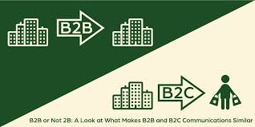
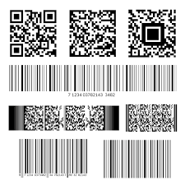
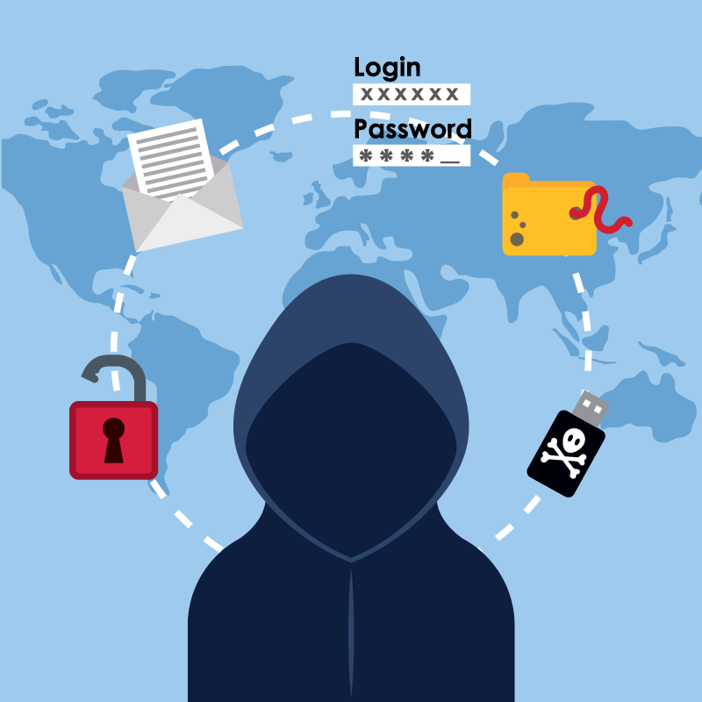
BENEFITS of TECHNOLOGY
*
E-Commerce-- The buying and selling of goods
and services over the internet.(B2B, B2C).
Universal Product Code helps scan what product
was bought, in what size and color and at what price.
A scanner at the checkout counter can read that
information and put it into a Database, which is an
electronic storage file where vast amounts of information
about customers (name, address, telephone numbers) are
stored.
Identity theft is the obtaining of individual personal
information for illegal purpose.
*
1-‹#›
‹#›
Notes:
‹#›

Slide 13


3. COMPETITIVE ENVIRONMENT
*
Firms should offer both high quality product and outstanding services at competitive price.
Need to know the competitors
1-‹#›
‹#›
Notes:
‹#›

Slide 14
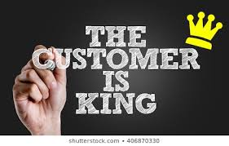

3. COMPETITIVE ENVIRONMENT
*
*
Two ways to compete:
by exceeding customer expectations
by restructuring and empowering the employees
1-‹#›
‹#›
Notes:
‹#›

Slide 15


4. SOCIAL ENVIRONMENT
*
Demography is the statistical study of human population with
regard to size, density and other characteristics, i.e., age, race, gender & income.
- Diversity has grown from just recruiting minority and female workers.
- Two income families
Changes in customers’ tastes and preferences
*
1-‹#›
‹#›
Notes:
‹#›

Slide 16


5. GLOBAL ENVIRONMENT
*
*
Significant changes in global environment are
Contributed by:
Increase of global competition
Increase of free trade among nations
1-‹#›
‹#›
Notes:
‹#›

Slide 17



5. GLOBAL ENVIRONMENT
*
*
Negative effects of globalization on businesses:
Wars and terrorism
Global Pandemic
How to stay updated with globalization?
1-‹#›
‹#›
Notes:
‹#›

Slide 18


6. Ecological Environment
*
The Ecological Environment
L
*
More than just climate change
Greening: The trend toward saving energy and producing products that cause less harm to environment.
1-‹#›
‹#›
Notes:
‹#›

Slide 19
PESTLE ANALYSIS
PESTLE Analysis (political, economic, social, technological, legal and environmental) is a management method whereby an organization can assess major external factors that influence its operation in order to become more competitive in the market. As described by the acronym, those six areas are central to this model. It offers people professionals insight into the external factors impacting their organization.

Slide 20
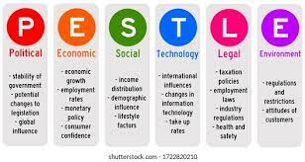

Slide 21
SWOT ANALYSIS
SWOT Analysis is a simple but useful framework for analyzing your organization's strengths, weaknesses, opportunities, and threats. It helps you to build on what you do well, to address what you're lacking, to minimize risks, and to take the greatest possible advantage of chances for success..

Slide 22
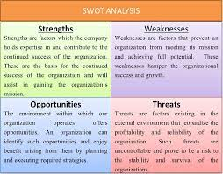

Slide 23
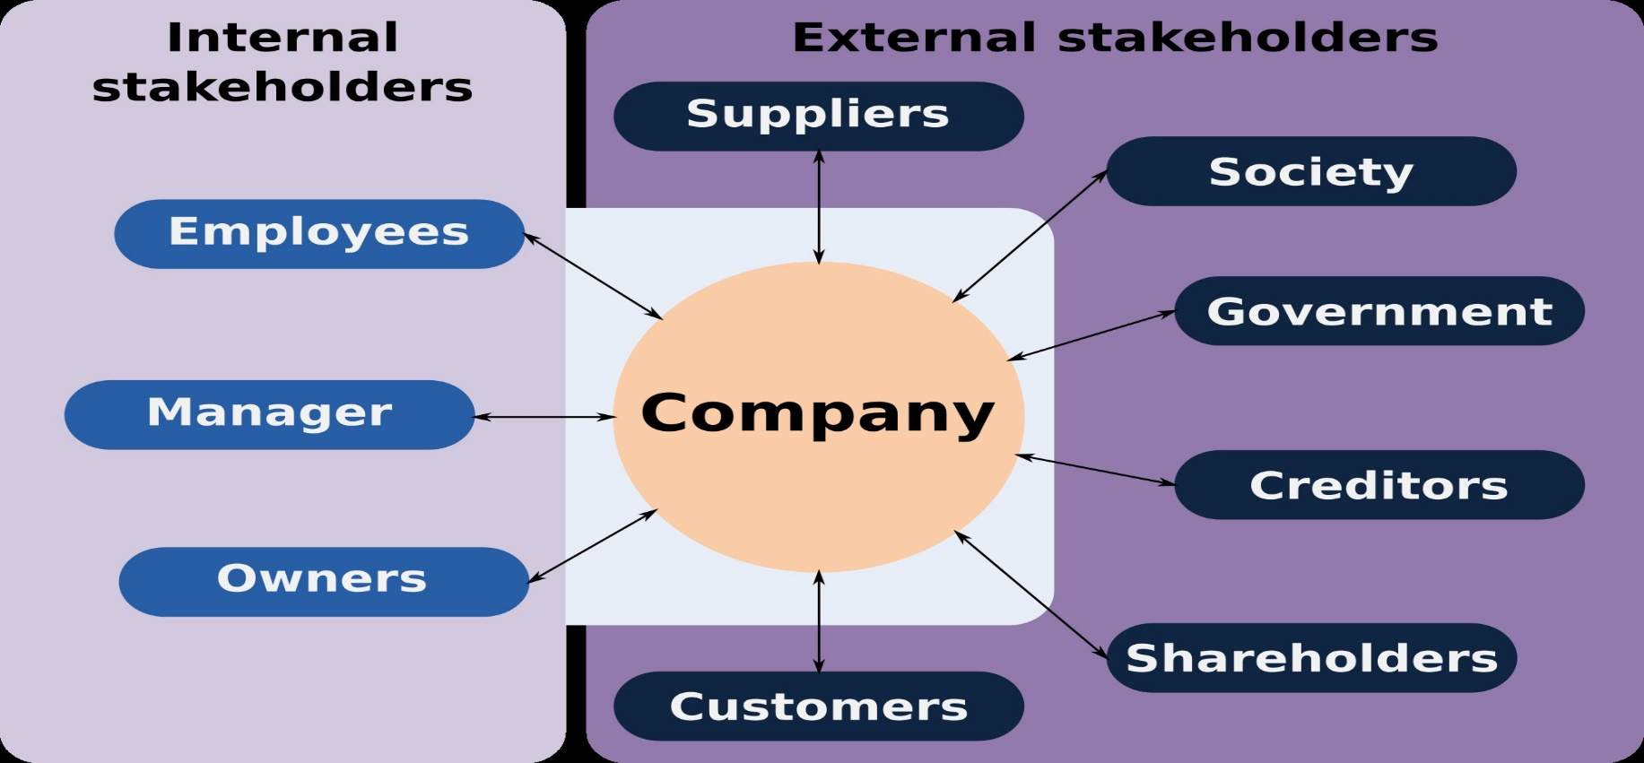
Stakeholders
*
*
Any individual or group who can affect or are affected by the achievement of a firm’s objectives
Stakeholders- customers, employees, stockholders, suppliers, government etc.
1-‹#›
Notes:
‹#›

